Slide 1
What is Communication?
Communication
The process of creating and exchanging information from one place to another.
Verbal communication
Communication in the form of spoken or written words.
Nonverbal communication
Communication in the form of gestures, eye contact, or tone of voice.

Slide 2
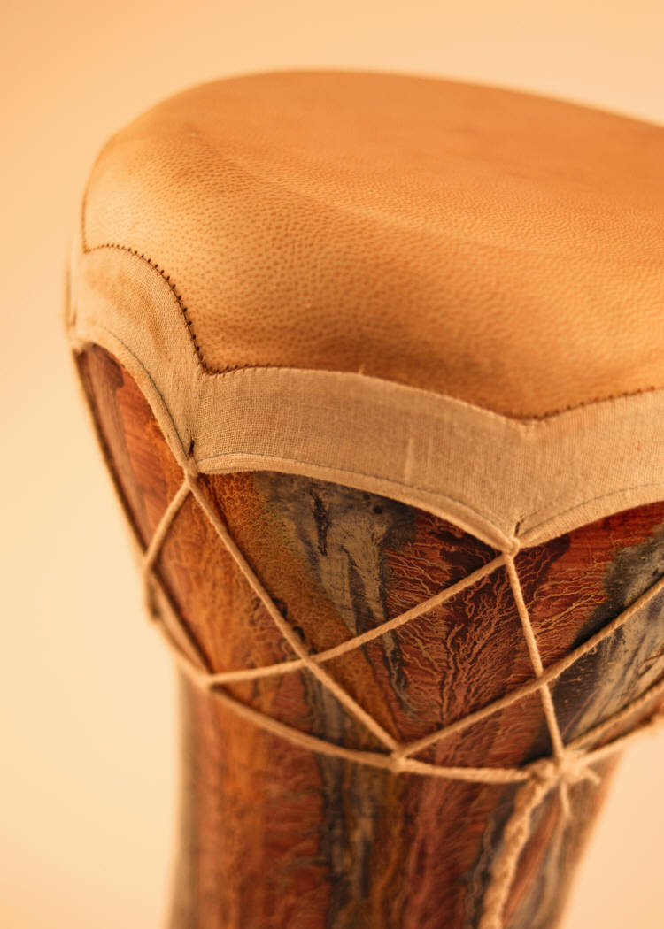
Non Verbal: Sound
Drums were one way to send signals to neighboring tribes and groups.
Different drumming patterns would tell them of concerns and events they needed to know.

Slide 3

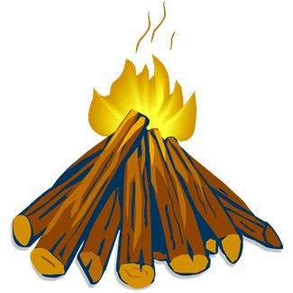
Non Verbal: Smoke Signals
Smoke signals were another way to send messages to people who were not close enough to use words.

Slide 4
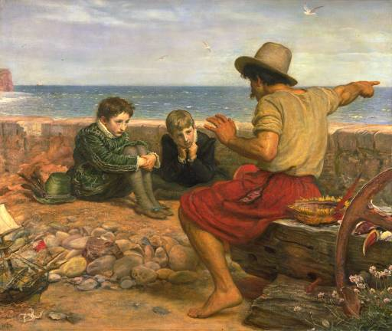
Verbal Storytelling
Before the written word, storytelling was a way for families and communities to pass on information.

Slide 5

Carrier pigeons
The homing pigeon is a variety of domestic pigeon (Columba livia domestica) derived from the rock pigeon, selectively bred to find its way home over extremely long distances, using magneto reception.
Magneto reception is a sense which allows an organism to detect a magnetic field to perceive direction, altitude or location.
Their skills made them used to carry messages as carrier pigeons or messenger pigeons

Slide 6
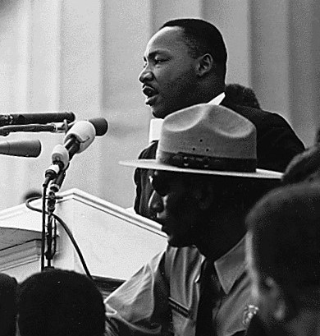
Speech
Speech is the expression of, or the ability to express thoughts and feelings by articulate sounds.
Human communication was revolutionized by speech.

Slide 7
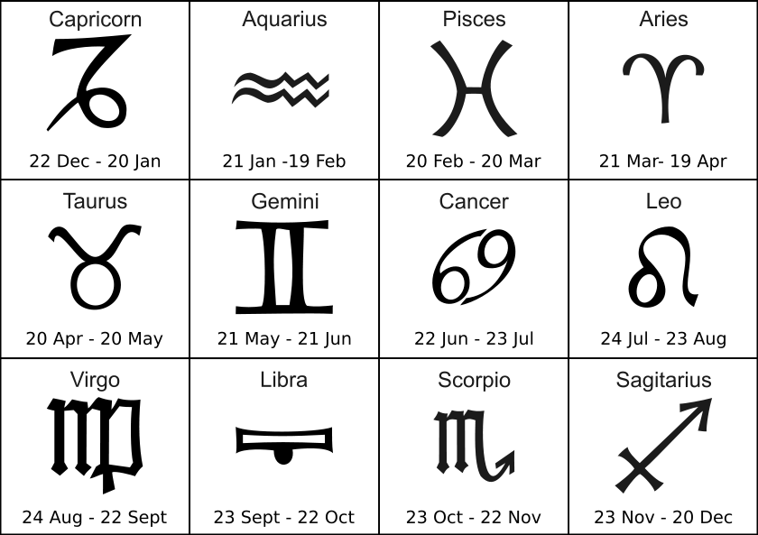
Symbols
Symbol - Something that represents or stands for something else
The imperfection of speech resulted in the creation of new forms of communication, improving both the range at which people could communicate and the longevity of the information.

Slide 8

Writing
a sequence of letters, words, or symbols marked on paper or other surface
appeared around 2700 BC

Slide 9
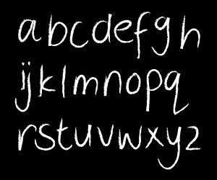
Alphabet
A set of letters or symbols in a fixed order
Used to represent the basic sounds of a language
In particular, the set of letters from A to Z
1700 BC

Slide 10
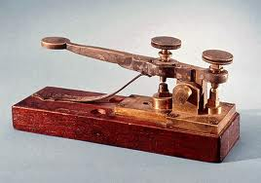
Telegraph
1831 Joseph Henry invents the first electric telegraph.
1832 Samuel Morse invents Morse Code.

Slide 11
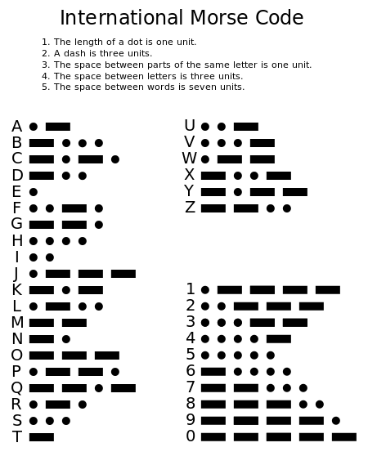

Slide 12
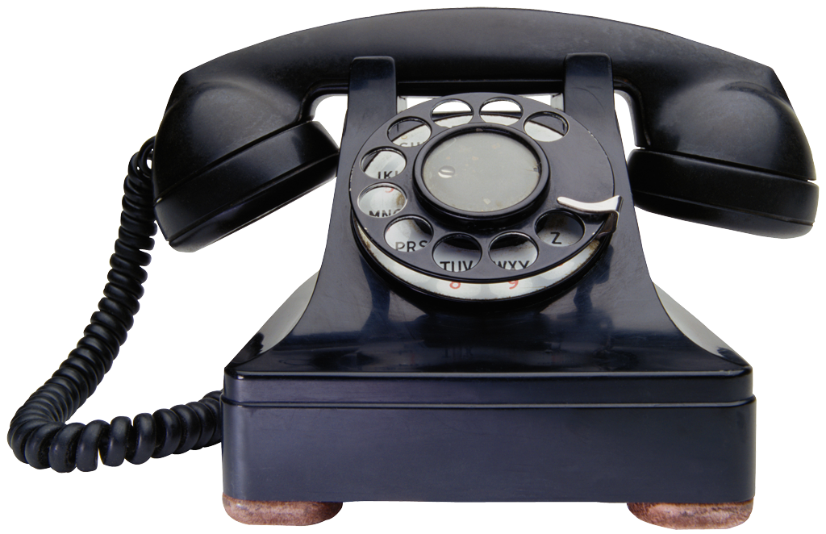
Telephone
Alexander Graham Bell invented the telephone in Boston in 1876.
A telephone converts sound, typically and most efficiently the human voice, into electronic signals suitable for transmission via cables or other transmission media over long distances, and replays such signals simultaneously in audible form to its user.
.

Slide 13
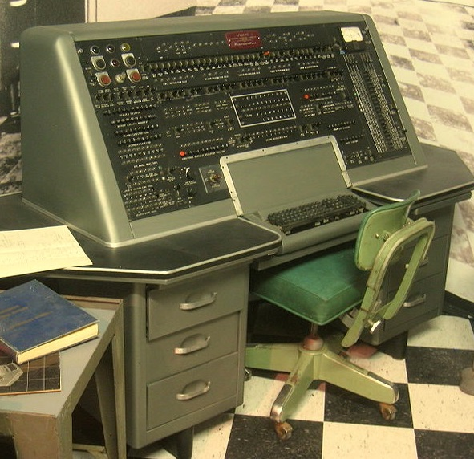
Computer
1951, The first commercially available, “mass produced” electronic computer entered the market
The computer was manufactured in the United States.

Slide 14
What is wireless?
Wireless simply means anything without wire
Wireless is a term used to describe telecommunications in which electromagnetic waves carry the signal over part or all of the communication path.
1896 Marconi recognized that longer waves propagate over larger distances and demonstrates a communication set-up over 3km

Slide 15
1896 - 1901 - Guglielmo Marconi
first demonstration of wireless telegraphy (Morse code - digital)
long wave transmission over longer distances (transatlantic) at an operating frequency of 1MHz
1906 - 1st World Admin. Radio Conf. (WARC -> WRC)
increasing popularity of radio systems and their extended use
ability to define BW using filters led to spectrum control
recommendations for the assignment of RF bands
1933 - Frequency modulation (E. H. Armstrong)

Slide 16
1907 - Commercial transatlantic connections
huge base stations (30 100m high antennas)
1915-Wireless voice transmission N.Y. - San Francisco
1920- Discovery of short waves by Marconi
reflection at the ionosphere
smaller sender and receiver -> due to the invention of the vacuum tube (1906 - Lee DeForest and Robert von Lieben)

Slide 17
1946 - Mobile Telephone Service (MTS) in US
introduced in 1946, it allowed telephone calls between fixed stations and mobile users through the mobile operator
one single powerful transmitter/receiver (base station) provided coverage of up to 50km
based on FM technology, each voice channel of 3kHz used 120KHz of spectrum, and only half duplex service was available
blocking probabilities were as high as 65% (only 12 simultaneous calls could be handled!)

Slide 18
1958 - A-Netz in Germany at 160MHz
analog cellular, connection setup only from the mobile station, no handover, 80% coverage, 1971 only 11000 customers
1972 - B-Netz in Germany at 160MHz
connection setup from the fixed network (location of the mobile station had to be known)

Slide 19
1 m
10 m
100 m
1 Km
10 Km
100 Km
1,000 Km
Mobile
Telephony
FM
Radio
MW
Radio
SW
Radio
Satellite
Links
Blueooth
WLANs

Slide 20

Bluetooth
Bluetooth is a wireless technology standard for exchanging data over short distances
It operates between 2.4 and 2.485 GHz
Invented by Ericson in 1994
The IEEE standardized Bluetooth as IEEE 802.15.1, but no longer maintains the standard.
It was originally conceived as a wireless alternative to RS-232 data cables (DB 9)
Features: Low power, easy to use, and low cost
Class 1- 100 mW (20 dBm) ~100 meters
Class 2 2.5 mW (4 dBm) ~10 meters
Class 3 1 mW (0 dBm) ~1 meter

Slide 21
WLAN
A wireless LAN is one in which a mobile user can connect to a local area network (LAN) through a wireless (radio) connection.
The IEEE 802.11 group of standards specify the technologies for wireless LANs.
IEEE published 802.11 in 1997, after seven years of work
802.11 standards use the ethernet protocol and CSMA/CA (carrier sense multiple access with collision avoidance)

Slide 22
Provides network connectivity over wireless media
An Access Point (AP) is installed to act as Bridge between Wireless and Wired Network
The AP is connected to wired network and is equipped with antennae to provide wireless connectivity
A client is always associated with one AP and when the client moves closer to another AP, it associates with the new AP (Hand-Off)
Three flavors:
802.11b
802.11a
802.11g

Slide 23
IEEE 802.11a
Makes use of 5-GHz band
Provides rates of 6, 9 , 12, 18, 24, 36, 48, 54 Mbps
Uses orthogonal frequency division multiplexing (OFDM)
IEEE 802.11b
802.11b operates in 2.4 GHz band
Provides data rates of 5.5 and 11 Mbps
Complementary code keying (CCK) modulation scheme
IEEE 802.11g
Supports data rates as high as 54 Mbps on the 2.4 GHz band
Provides backward compatibility with 802.11b equipment

Slide 24
CSMA/CD – CSMA/Collision detection
For wire communication
No control BEFORE transmission
Generates collisions
Collision Detection
CSMA/CA – CSMA/Collision Avoidance
For wireless communication
Collision avoidance BEFORE transmission
Difference in energy/power for transmit & receive
Difficult to distinguish between incoming weak signals, noise, and effects of own transmission

Slide 25
Generations of wireless communication systems

Slide 26
1G
Nordic Mobile Phone in October 1981
150 MHz in Finland and 450 MHz
Purely analog
Cell size: 2 to 3 km
Voice channel is transmitted with FM modulation
AMPS(Advanced Mobile Phone Service) in October 1983
FDMA

Slide 27
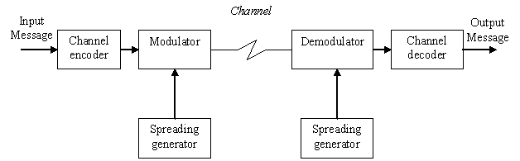
Block diagram

Slide 28
AM
Amplitude Modulation is the simplest and earliest form of transmitters
AM applications include:
broadcasting in medium- and high-frequency applications,
CB radio, and
aircraft communications

Slide 29
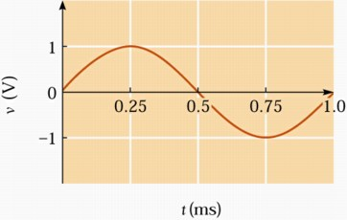
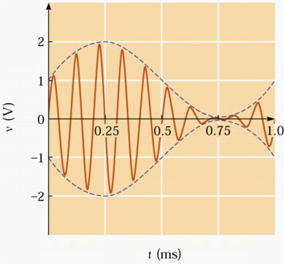
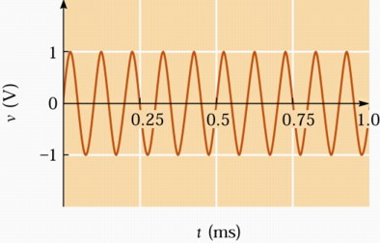
AM
In amplitude modulation, the amplitude (signal strength) of the carrier wave is varied in proportion to the waveform being transmitted.
The information signal varies the instantaneous amplitude of the carrier

Slide 30
FM
Frequency Modulation (FM) is the encoding of information in a carrier wave by varying the instantaneous frequency of the wave.
This contrasts with amplitude modulation, in which the amplitude of the carrier wave varies, while the frequency remains constant.

Slide 31
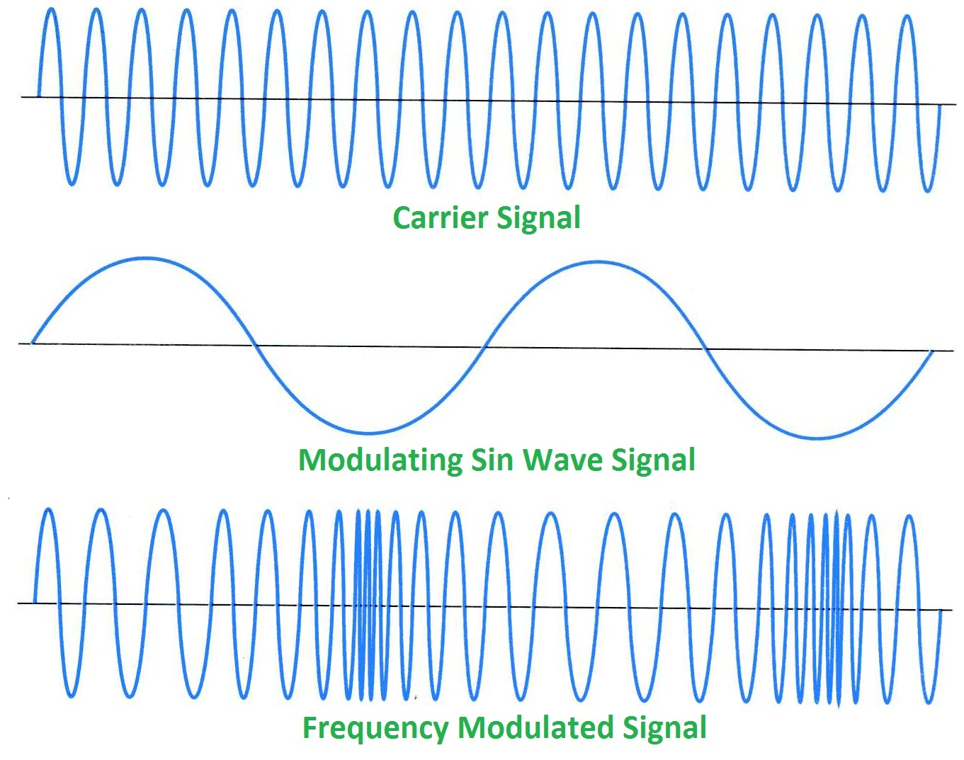
FM

Slide 32
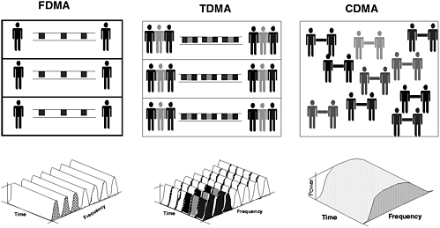
FDMA, TDMA, and CDMA
Frequency Division Multiple Access (FDMA) permits individual allocation of single or multiple frequency bands, or channels to the users.
Time Division Multiple Access (TDMA) works by dividing a radio frequency into time slots and then allocating slots to multiple calls. In this way, a single frequency can support multiple, simultaneous data channels
Code Division Multiple Access (CDMA) uses spread spectrum technology with the use of different codes to separate between different stations or users rather than different frequencies of time slots as in the case of FDMA and TDMA technologies.

Slide 33
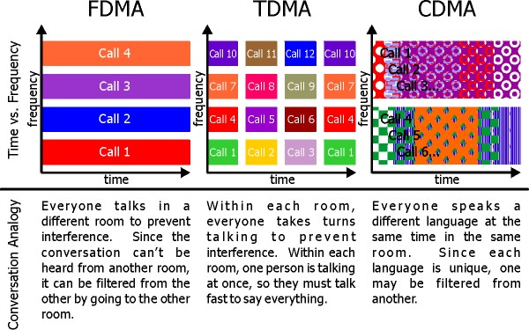

Slide 34

2G
GSM (Global System for Mobile communication) in July 1991
900 MHz in 1992
1800 MHz in 1994
Fully digital
TDMA
Voice is encrypted, MMS, and International roaming
D-AMPS in 1993
Circuit switched

Slide 35
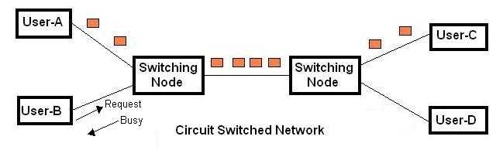
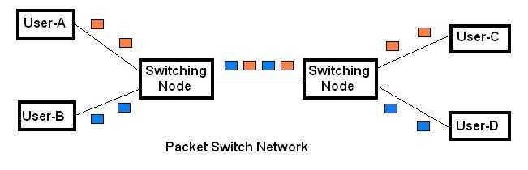
Difference between Circuit and packet switching

Slide 36
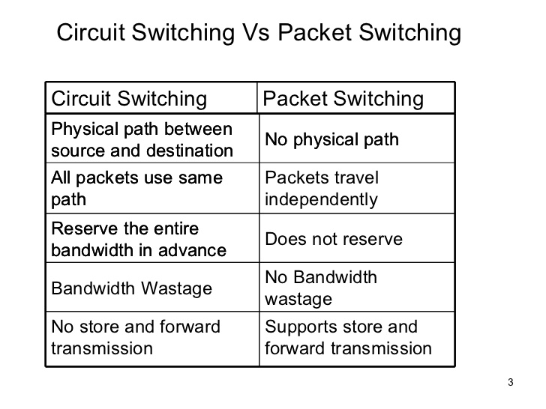

Slide 37

2.5 G
GPRS (General Packet Radio Service)
From circuit switched domain to packet switched domain
Enables data transfers through cellular networks
It is used for mobile internet, MMS and other data communications
In theory the speed limit of GPRS is 115 kbps, but in most networks it is around 35 kbps.
GPRS is based on Global System for Mobile Communication (GSM)

Slide 38

2.75 G
EDGE (Enhanced Data rates for GSM Evolution)
Enhanced GPRS
EDGE was deployed on GSM in 2003
Evolution of GSM, & GPRS which used 8PSK modulation
Transmits data at up to 384 kilobits per second (Kbps).
Achieves data transfer rates up to 384 kbps

Slide 39
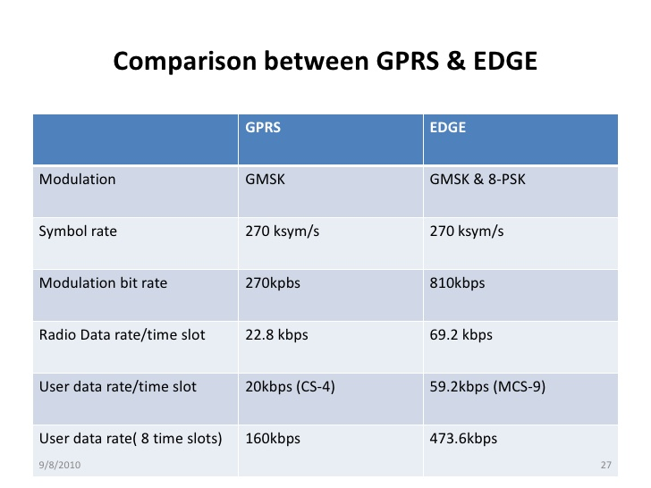
Notes:
GMSK=Gaussian Minimum Shift Keying

Slide 40
Gaussian Minimum Shift Keying (GMSK) is a form of continuous-phase FSK
The phase change is changed between symbols to provide a constant envelope. Consequently it is a popular alternative to QPSK.
The RF bandwidth is controlled by the Gaussian

Slide 41
Spread spectrum
Spread-spectrum techniques are methods by which a signal generated with a particular bandwidth is deliberately spread in the frequency domain, resulting in a signal with a wider bandwidth.
Spread signals are intentionally made to be much wider band than the information they are carrying to make them more noise-like.

Slide 42
Spread spectrum
Spread Spectrum signals use fast codes that run many times the information bandwidth or data rate.
These special "Spreading" codes are called "Pseudo Random" or "Pseudo Noise" codes. They are called "Pseudo" because they are not real Gaussian noise.
Features: Anti-Jam (AJ) and Low Probability of Intercept (LPI)
It has two techniques:
1. Direct Sequence Spread Spectrum (DSSS)
2. Frequency Hopping Spread Spectrum (FHSS)

Slide 43
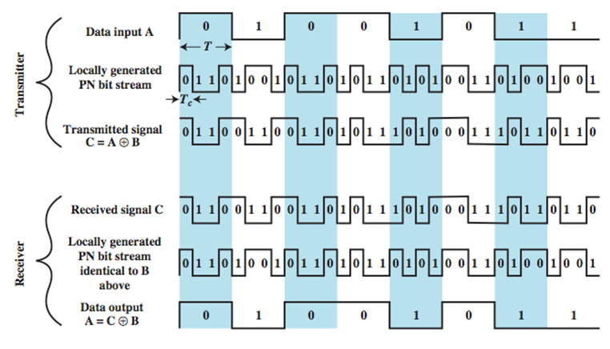
DSSS

Slide 44
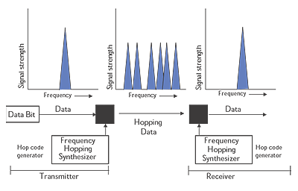
FHSS

Slide 45
3G
UMTS (Universal Mobile Telecommunications System) in 2001
Digital wideband packet
Uses different IPs
3G based on GSM standards
Up to 2Mbps
Uses W-CDMA
Mobile TV, Video calling, and Video on Demand (VOD)

Slide 46
WCDMA
Wideband-CDMA (WCDMA) was developed by the GSM community to support 3G
WCDMA uses frequency bands of 5Mhz wide
Most WCDMA phones include GSM as well, for backward compatibility
WCDMA borrows certain technology ideas from CDMA, as the name implies, but is in fact very different and incompatible with phones and networks using "CDMA" technology
The frequency bands for WCDMA are as follows: Europe and Asia - 2100MHz, North America - 1900MHz and 850MHz

Slide 47
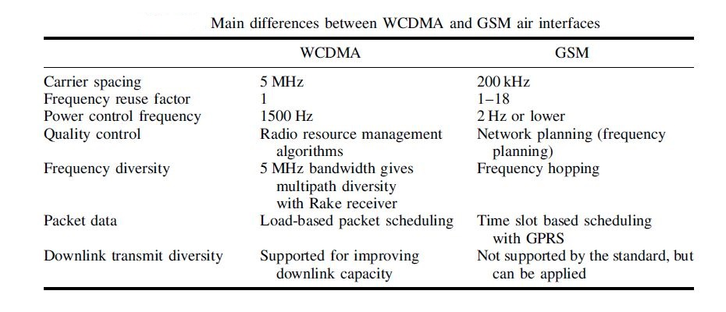

Slide 48
3.5G
High Speed Packet Access (HSPA) is a combination of two mobile telephony protocols, High Speed Downlink Packet Access (HSDPA) and High Speed Uplink Packet Access (HSUPA)
The peak downlink speed of the network can reach 14.4 Mbps, and the peak uplink speed can reach 5.7Mbps.

Slide 49
4G
Digital Wideband packet
All-IP (Uses a single language to transfer data)
Very high Throughput
100-300 Mbps
OFDM(Orthogonal Frequency Division Multiplexing)
Feature: Cloud computing
Race track for you only (Running race)

Slide 50
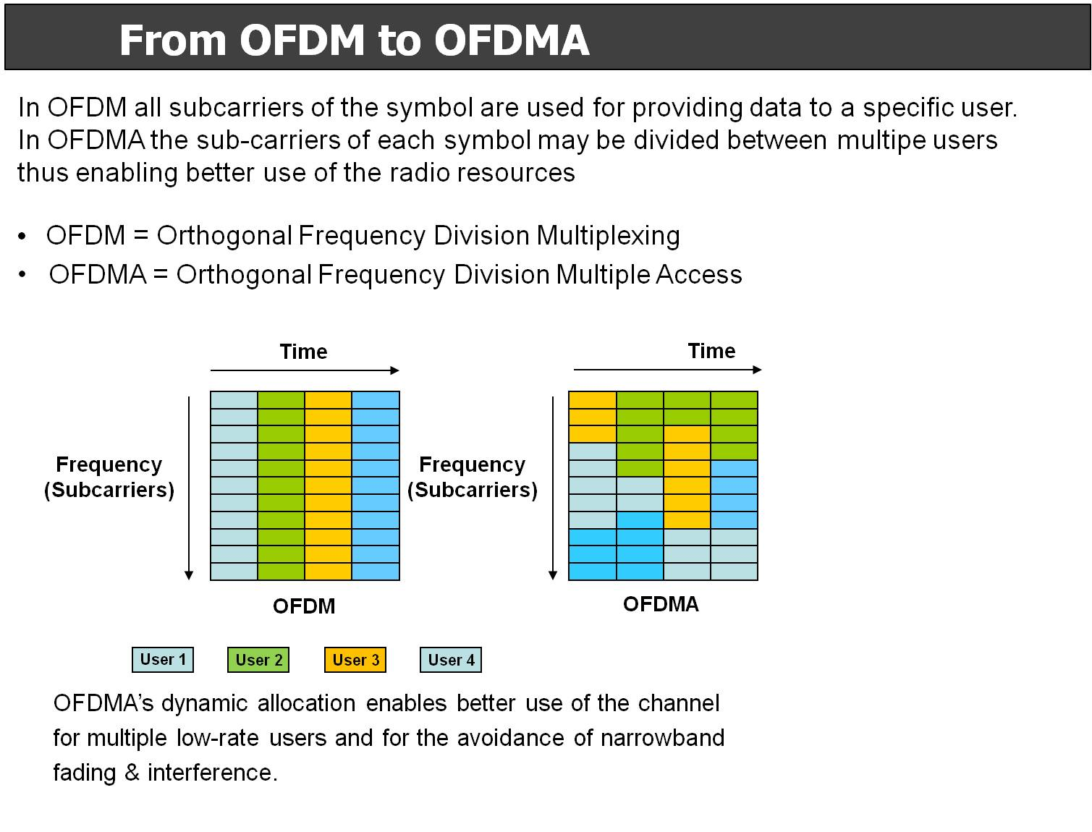
OFDM
Orthogonal frequency-division multiplexing (OFDM) is a method of digital modulation in which a signal is split into several narrowband channels at different frequencies.

Slide 51
4G continued
WiMax (Worldwide Interoperability for Microwave Access) in 2009
IEEE 820.16e
30 to 40 Mbps
LTE (Long Term Evolution)
Based on GSM/EDGE and UMTS/HSPA
data transfer rates of 100 Mbps
Trademark of ETSI (European Telecommunications Standards Institute)
Bandwidth is shared with other users

Slide 52
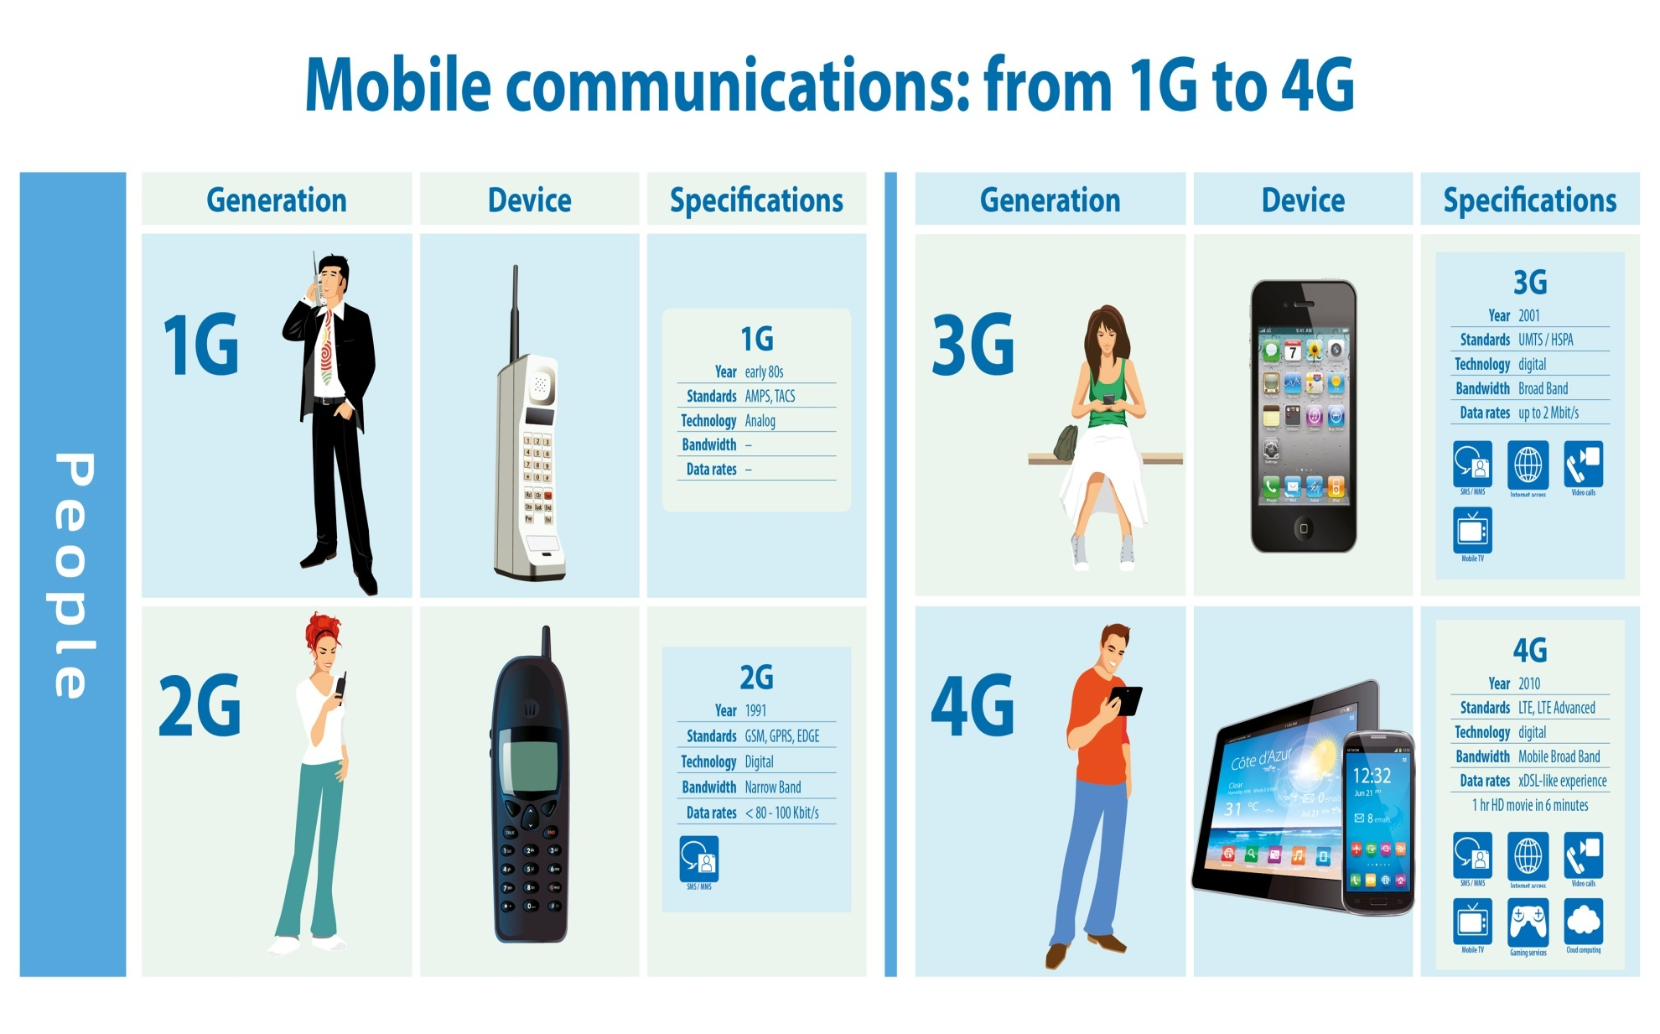

Slide 53
5G
5G is the next generation of wireless communications
5G will provide a high bandwidth with very low latency.
5G is not about changing the existing technologies but to enhance and support them with new technologies that require very high speed data
It has hit the market now and expected be in use up to 2040.

Slide 54
Technologies investigated in 5G
Millimeter wave
Massive MIMO
Cognitive radio networks
Visible light communications

Slide 55
Millimeter wave
It was discovered by Sir J.C Bose in 1897.
It has a frequency range of 30 to 325 GHz and the wavelength is from 1 to 10 millimeters, hence the name.
It depends primarily on atmospheric oxygen, humidity, fog, and rain.
It opens up more spectrum.
The shorter the wavelength, the shorter the transmission range. This can be overcome by using high sensitivity receiver , high transmit power, and high antenna gains.

Slide 56
Massive MIMO
Massive MIMO uses a very large number of service antennas (e.g., hundreds or thousands) that are operated fully coherently and adaptively
The more antennas the transmitter/receiver is equipped with, the more the possible signal paths and the better the performance in terms of data rate and link reliability
Works on the principle of Time Division Duplexing (TDD)
It is possible to take massive MIMO a step further for 5G mobile communications by replacing an antenna array of N elements with N individual antennas distributed widely through the environment on separate buildings, lamp posts, etc.

Slide 57
Massive MIMO
For this to work, the path from the sender to the receiver must be the same as the path from the receiver to the sender (At same frequency).
Massive MIMO can increase the capacity 10 times or more and simultaneously, improve the radiated energy-efficiency in the order of 100 times,
Can be built with inexpensive low-power components, enables a significant reduction of latency, simplifies the multiple-access layer,…

Slide 58
Cognitive radio (CR) is a form of wireless communication in which a transceiver can intelligently detect which communication channels are in use and which are not, and instantly move into vacant channels while avoiding occupied ones.
Visible light communication (VLC) is a data communications medium which uses visible light between 400 and 800 THz (780–375 nm). VLC is a subset of optical wireless communications technologies.

Slide 59
5G Future
Integration of access technologies into one seamless experience
Evolution
and / or
and / or
Revolution
Complementary new technologies
Massive MIMO
D2D Communications
Ultra-Dense Networks
Respond to traffic explosion
Extend to novel applications
Ultra-Reliable Communications
10 x longer battery life
for low power M2M
Moving Networks
10 -100 x higher typical user rate
1000 x higher mobile data volume per area
10 -100 x higher number of connected devices
Higher Frequencies
Massive Machine Communications
5 x reduced E2E latency
Existing technologies in 2012
3G
Wifi
4G

Slide 60
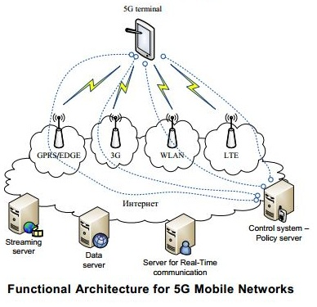
Architecture of 5G

Slide 61
Advantages
Data Bandwidth of 1Gbps or higher.
Dynamic information access.
Finest Quality Of Service(QOS).
Pages will upload almost instantly.
Support interactive multimedia, voice, streaming video, Internet, and other broadband services.

Slide 62
Disadvantages
Since 5G services are likely to run on ultra-high spectrum bands, which travel shorter distances compared with lower bands, they may be more suited to enhanced indoor coverage.
Higher frequencies could be blocked by buildings and they lose intensity over longer distances. That means, offering wider coverage would be a challenge.
The speed, this technology is claiming seems difficult to achieve (in future, it might be) because of the incompetent technological support in most parts of the world.

Slide 63
Area of implementation
5G will be used in:
Industrial automation,
Doctors using robots to perform surgery remotely,
Smart TVs that need a very high amount of data,
Internet of Things,
Autonomous vehicles…

Slide 64
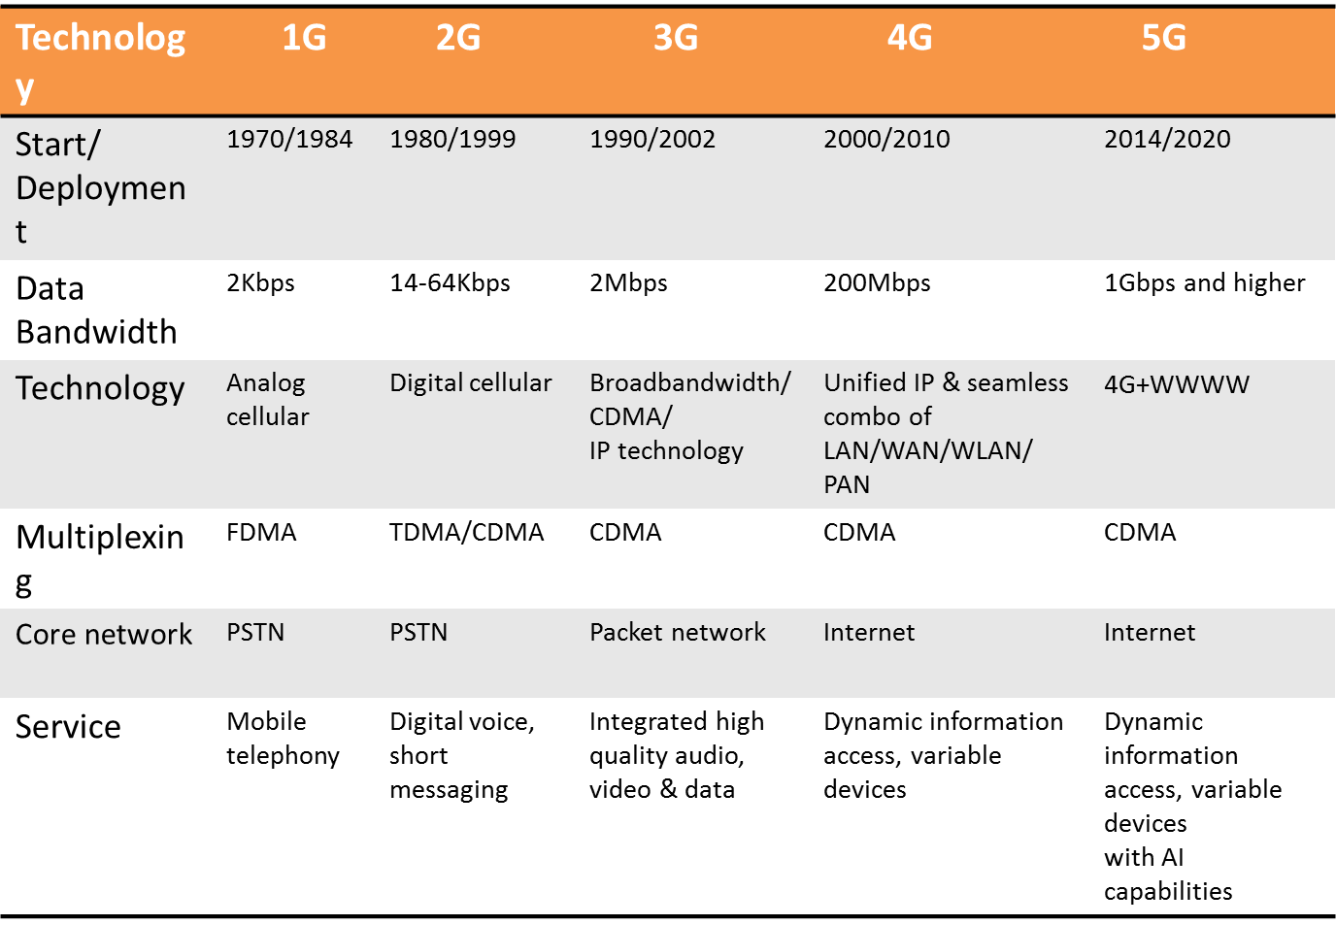
Comparison of all the 5 generations

Slide 65
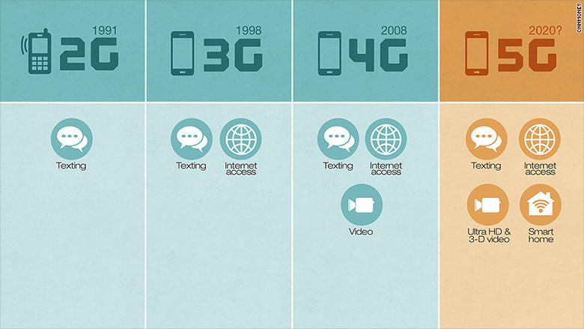

Slide 66
Thank you! ☺

